Slide 1


Slide 2

HTTP Strict-Transport-Security Understanding HSTS

Slide 3
Contents
What is HSTS?
How does HSTS Header work?
Importance of HSTS
How to check for HSTS Vulnerability?
Impact.
Mitigation.
Live Demo.

Slide 4
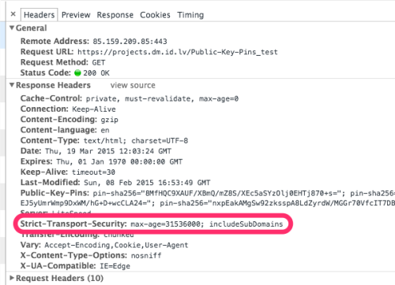
HSTS
The HTTP Strict-Transport-Security response header (HSTS) informs browsers that the site should only be accessed using HTTPS, and that any future attempts to access it using HTTP should automatically be converted to HTTPS.

Slide 5
Working
If a website accepts a connection through HTTP and redirects to HTTPS, visitors may initially communicate with the non-encrypted version of the site before being redirected, and an attacker can exploit this redirection to a malicious site instead of the secure version of the original site.
The HTTP Strict Transport Security header informs the browser that it should never load a site using HTTP

Slide 6
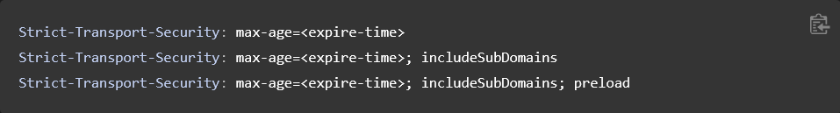
max-age: (Required) - Time in seconds for the browser to retain this host’s policy (1 year here)
max-age=0 will delete the HSTS policy
includeSubdomains: (Optional) - HSTS policy applies to any subdomains of the host’s domain name
preload: (Optional) - This directive can be seen for websites that ask to be added in preload list as an opt-in signal from the server

Slide 7
IMPORTANCE OF HSTS

Slide 8
IMPACT
MiTM Attack
Can be escalated to- Data Theft, Unauthorized access, Injection of malicious codes/payloads
Cookie Hijacking
Downgrade Attacks

Slide 9
MITIGATION
Configure HTTPS in your web server to your website.
SSL/TLS
HSTS Header
Regularly audit your website for missing headers and configuration mistakes.
Test & Verify

Slide 10
TESTING
First method : Use ssltest from Qualys ssllabs https://www.ssllabs.com/ssltest/
Second method : In terminal curl -s -D- https://www.websiteexample.com/ | grep -i strict

Slide 11
References
https://irsyadsec.medium.com/hsts-vulnerability-write-up-f4f14888a613
https://developer.mozilla.org/en-US/docs/Web/HTTP/Headers/Strict-Transport-Security
https://www.youtube.com/watch?v=j9QmMEWmcfo
https://cheatsheetseries.owasp.org/cheatsheets/HTTP_Strict_Transport_Security_Cheat_Sheet.html
https://datatracker.ietf.org/doc/html/rfc6797

Slide 12

Thank you

